Slide 1
Exception Handling (try, throw, except)

Slide 2
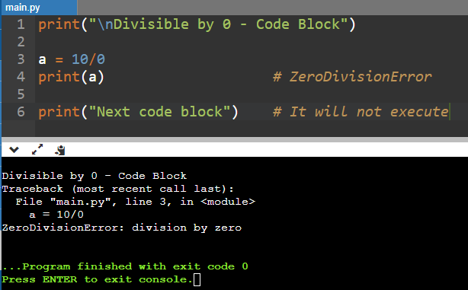
Without Exception:
In ATM, you deposit 2000 Rs but your Account has only 1000 Rs
Its shows an error
Next function(Exit) does not work

Slide 3
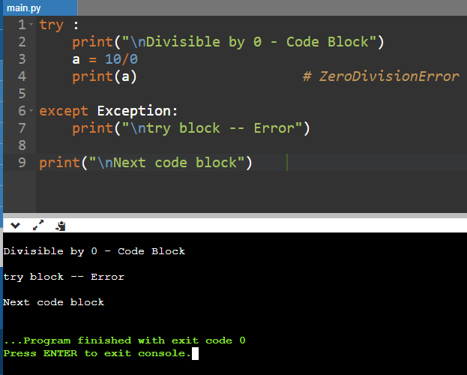
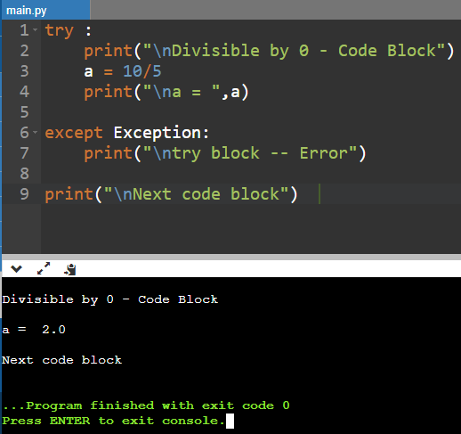
With Exception: (try, except)
In try block -- you deposit 2000 Rs but your Account has only 1000 RS...
Its shows an error – except block
Next function(Exit) does works even try block shows error
With Exception: Error
With Exception: No Error

